Slide 1

Predicting Customer Churn with Logistic Regression
Summer Internship- 2026
Name: Kanak
Supervisor: Prof. Millie Pant
Mentor: Ms. Riya and Mr. Harjeet Applied Mathematics & Scientific Computing
Indian Institute of Technology Roorkee

Slide 2

Agenda
1
Problem Statement & Objective
6
Model Building — Logistic Regression
2
Dataset Overview
7
Model Performance & Evaluation
3
Data Cleaning & Preprocessing
8
Feature Importance & Business Insights
4
Exploratory Data Analysis
9
Conclusion & Recommendations
5
Multicollinearity Check (VIF)
1

Slide 3
Problem Statement & Objective and Dataset Overview
The Problem
The Objective
Telecom providers lose recurring revenue every time a customer cancels service.
Retaining an existing customer is far cheaper than acquiring a new one.
Nearly 1 in 4 customers in this dataset has already churned.
Build a model that predicts which customers are likely to churn.
Identify the customer attributes that drive churn.
Translate findings into actionable retention strategies.
7,043
Customers
21
Original Features
18
Features Used
Churn
Target Variable
Feature groups
Demographics: gender, senior citizen status, partner, dependents
Account details: tenure, contract type, billing method, monthly charges
Services subscribed: internet, online security & backup, device protection, tech support, streaming TV/movies, multiple lines
2

Slide 4
Data Cleaning & Preprocessing
1
Drop Irrelevant / Redundant Columns
Removed customerID (identifier), TotalCharges (redundant with tenure × MonthlyCharges), and PhoneService (near-constant, low signal).
2
Missing Value Check
Verified with df.isnull().sum() — zero missing values across all remaining 18 columns.
3
Categorical Encoding
Applied sklearn LabelEncoder to all categorical fields: gender, Partner, Dependents, MultipleLines, InternetService, OnlineSecurity, OnlineBackup, DeviceProtection, TechSupport, StreamingTV, StreamingMovies, Contract, PaperlessBilling, PaymentMethod.
4
Feature Scaling
Standardized all features with StandardScaler before model training.
Variance Inflation Factor (Top Features)
Feature | VIF
MonthlyCharges | 8.32
tenure | 7.47
Contract | 4.11
StreamingMovies | 3.17
StreamingTV | 3.15
Partner | 2.82
PaperlessBilling | 2.82
Checked multicollinearity with Variance Inflation Factor (VIF) — all features scored well below the common threshold of 10.
3

Slide 5
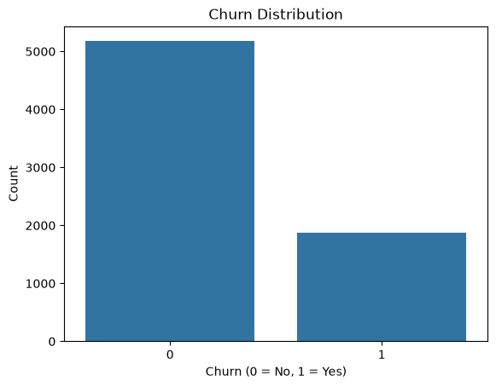
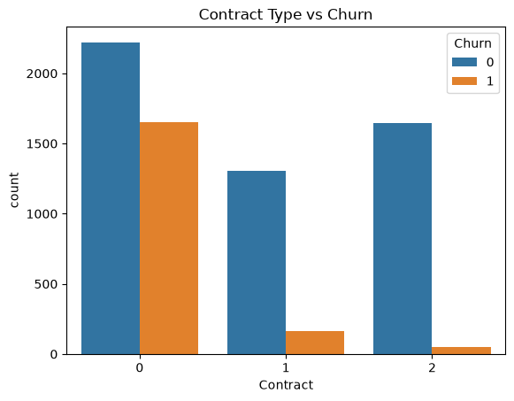
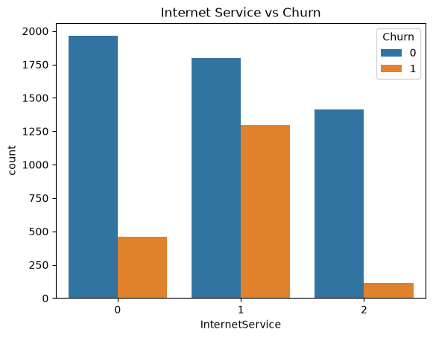
Exploratory Analysis: Class Imbalance & Categorical Drivers
Churn is imbalanced: ~26.5% of customers churned.
Month-to-month contracts churn far more than long-term ones.
Fiber-optic internet customers churn at the highest rate.
4

Slide 6
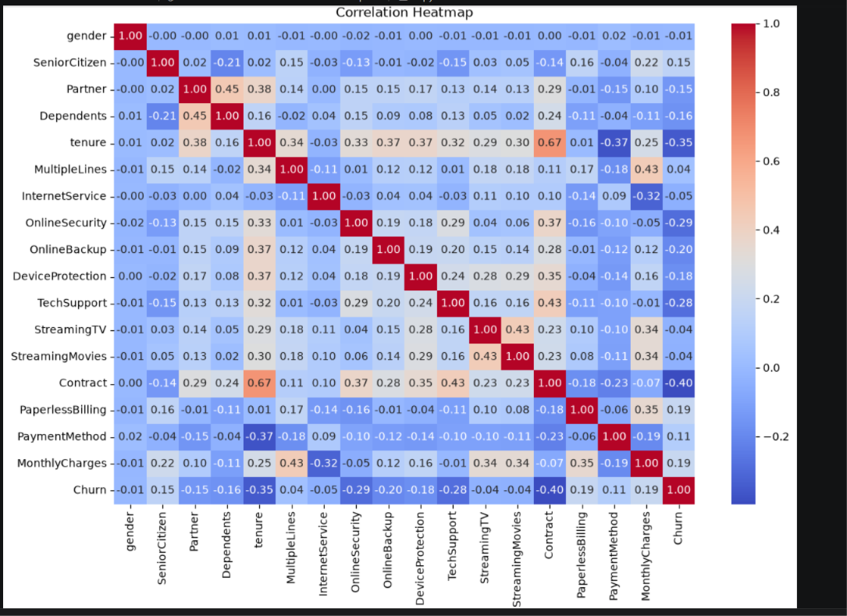
Exploratory Analysis: Correlation & Numeric Drivers
Correlation heatmap across all encoded features
5

Slide 7
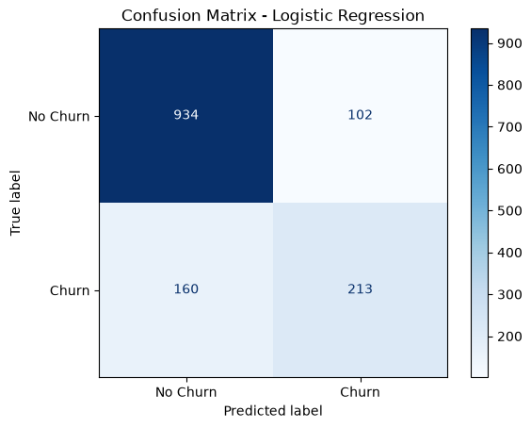
Model Building & Performance
Logistic Regression · 80/20 train-test split
81.41%
0.858
Accuracy
ROC-AUC
Classification Report
Class | Precision | Recall | F1-score
No Churn (0) | 0.85 | 0.90 | 0.88
Churn (1) | 0.68 | 0.57 | 0.62
Model correctly identifies 90% of loyal customers, and captures 57% of customers who actually churn — a solid baseline for a linear model.
Confusion Matrix
6

Slide 8
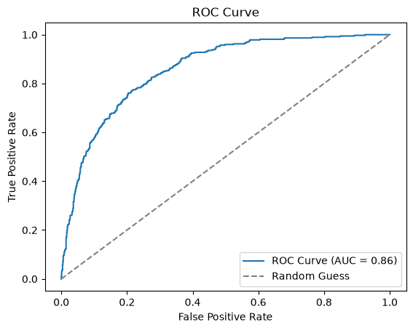
ROC Curve & Key Churn Drivers
Top Odds-Ratio Drivers (Full Model)
Feature | Odds Ratio | Effect
MonthlyCharges | 1.82× | Increases churn
PaperlessBilling | 1.21× | Increases churn
MultipleLines | 1.14× | Increases churn
Contract | 0.54× | Reduces churn
tenure | 0.46× | Reduces churn
OnlineSecurity | 0.78× | Reduces churn
ROC Curve (AUC = 0.858)
Longer tenure and longer-term contracts are the strongest protective factors. Higher monthly charges and paperless billing are the strongest churn risk factors.
7

Slide 9
Conclusions & Recommendations
Recommendations
Target month-to-month, high-bill customers with retention offers.
Promote annual/two-year contracts and bundled security & support add-ons.
Explore tree-based models (Random Forest) to push accuracy further.
Conclusions
Logistic regression achieves 0.86 ROC-AUC — a strong, interpretable baseline.
Contract type, tenure and monthly charges are the dominant churn drivers.
8

Slide 10
References
Dataset: Telco Customer Churn (Customer-Churn2.csv), IBM Sample Data Sets.
Pedregosa, F. et al. (2011). Scikit-learn: Machine Learning in Python. JMLR 12, 2825–2830.
McKinney, W. (2010). Data Structures for Statistical Computing in Python. Proc. SciPy.
Hosmer, D.W., Lemeshow, S., Sturdivant, R.X. (2013). Applied Logistic Regression, 3rd ed. Wiley.
9

Slide 11

Thank You

